Slide 1

Machine learning and AI
Title: Heart Disease Prediction Using Machine Learning
Subtitle: Model Evaluation and Comparison
Presenter's Name: Mahdi Mohammadzadeh, Ali Arabi
Date: 13/05/2025

Slide 2

Project Overview
This project aims to build machine learning models that can predict the presence of heart disease based on clinical features. The goal is not only to create accurate models but also to compare them and understand which approach is most suitable for real-world deployment.

Slide 3
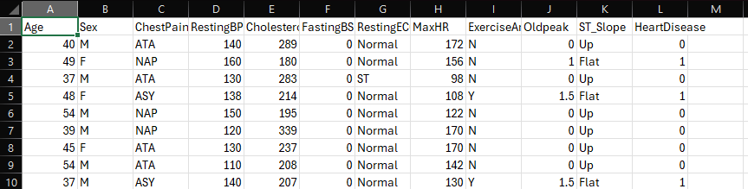
Dataset Description Explanation
We used a public dataset with 918 patient records, each containing information such as age, sex, blood pressure, cholesterol, and results of various tests. The target variable indicates whether the patient is diagnosed with heart disease (1) or not (0).

Slide 4

Data Preprocessing Explanation
To make the dataset ready for modeling, categorical variables were encoded numerically using LabelEncoder. We standardized the numerical features using StandardScaler to ensure fair treatment across models. The dataset was then split into training (80%) and testing (20%) sets.

Slide 5

Models Used Explanation

Slide 6

algorithms
Four classification models were chosen for evaluation. These cover both linear and non-linear methods, from interpretable algorithms like Logistic Regression to more complex ensemble techniques like Random Forest.

Slide 7
Why These Models?
Random Forest is robust to overfitting and works well with nonlinear data.
Logistic Regression offers interpretability and is a reliable baseline.
SVM performs well in high-dimensional spaces.
KNN is a simple algorithm that is useful for comparison and concept demonstration.

Slide 8
Evaluation Metrics Explanation
Accuracy: Overall correct predictions
Precision/Recall: To evaluate how well each class is predicted
F1-Score: Balance between precision and recall
Cross-validation: Ensures results are not specific to a single split
Confusion Matrix: Provides class-wise error analysis

Slide 9
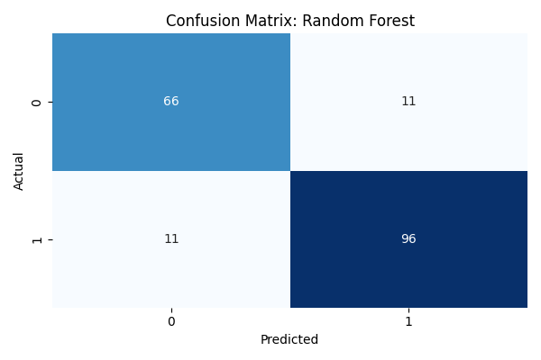
Random Forest Performance Explanation
Random Forest showed the best results with 88% accuracy and strong F1-scores for both classes. Its confusion matrix indicates balanced prediction, meaning it handles both diseased and non-diseased cases well. It also had the highest cross-validation accuracy.

Slide 10
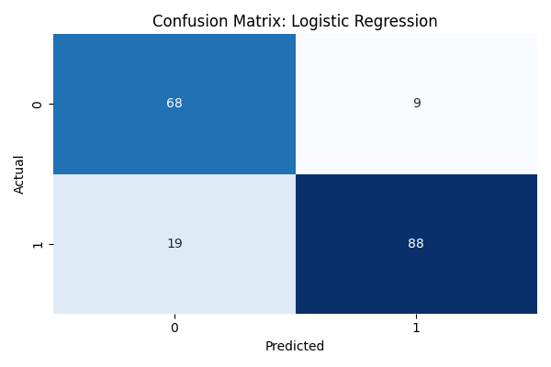
Logistic Regression Performance Explanation
Despite being a simple linear model, Logistic Regression achieved 84.8% accuracy. However, it misclassified more positive (diseased) cases, as reflected in its confusion matrix. It remains a strong model, especially when interpretability is needed.

Slide 11

SVM Performance Explanation
SVM also performed well with 86.4% test accuracy. However, its lower cross-validation accuracy (68.4%) suggests it may not generalize as well as expected. SVM often requires careful parameter tuning and scaling.

Slide 12
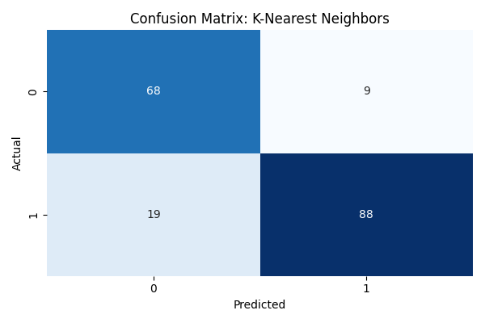
KNN Performance Explanation
KNN matched Logistic Regression in test accuracy (84.8%) but had lower cross-validation accuracy. It’s more sensitive to noisy or imbalanced data, as shown by the higher number of misclassifications.

Slide 13
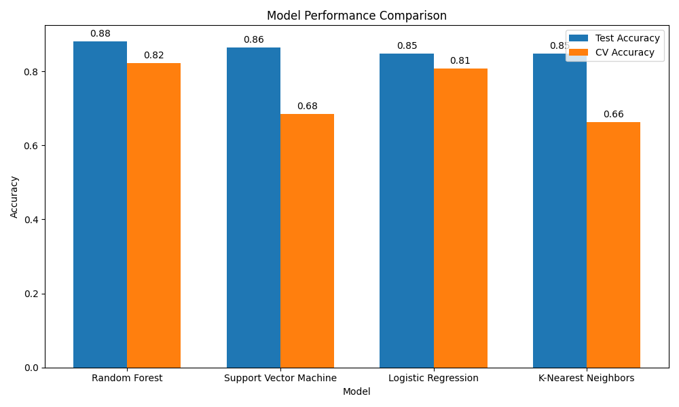
Model Comparison Table Explanation
The table summarizes test and cross-validation accuracy. Random Forest leads in both metrics, making it the most reliable model overall.

Slide 14
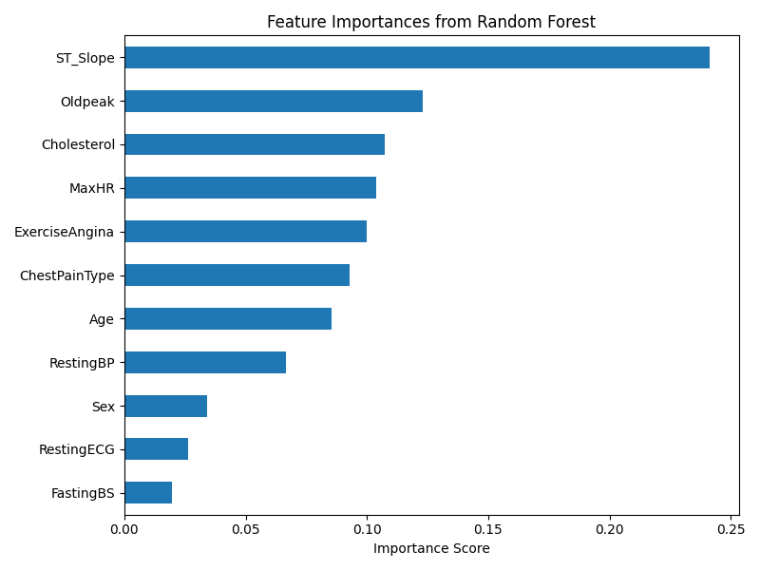
Feature Importance (Random Forest)
Random Forest provides insights into which features influenced decisions. Age, ST_Slope, Cholesterol, and ChestPainType were most important — all of which align with medical understanding of heart disease risk factors.

Slide 15

Conclusion
Random Forest is the most accurate and generalizable model. It handles both classes well, is interpretable through feature importance, and has consistent performance across multiple metrics. It is the best candidate for deployment.

Slide 16

Thank you!
Grazie!

